Slide 1
A Health monitor
By: Callum Owen-Bridge (15002504)

Slide 2
Problem
People are struggling to monitor their ongoing health problems
People are unable to monitor their health in their workplace
Patient’s feel that consultation results from health care professionals are slow

Slide 3
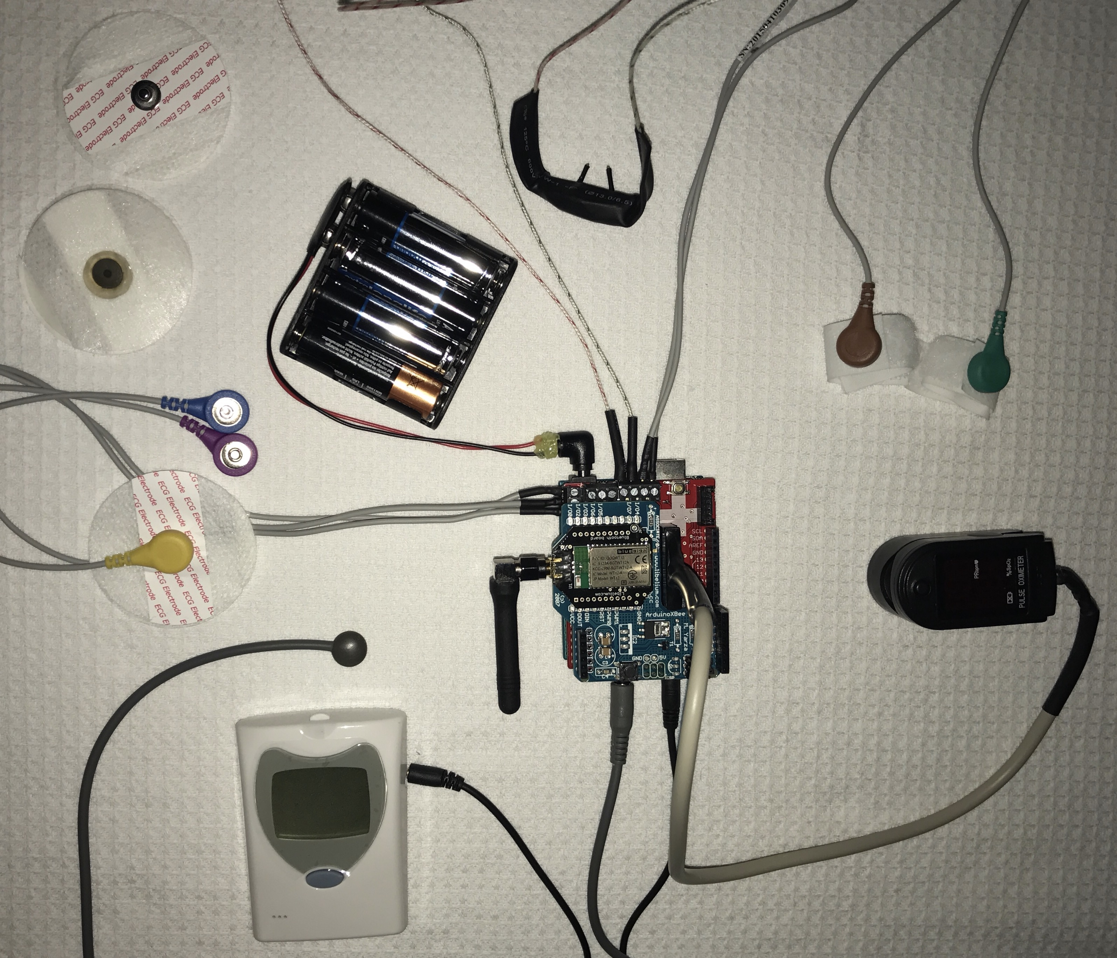
Solution
Electrode
Air flow
Battery Pack
Galvanic Skin Response
ECG/EMG
Pulse-oximeter
Thermometer
Monitor
Glucometer

Slide 4
Solution
Portable, accurate and provides fast results
Measures multiple vital signs of the human body
The data can be stored on a computer and accessed by health care professionals
Continuous data

Slide 5
Solution - device
The device has an array of sensors and is modular
It can measure:
Blood oxygen concentration
Air flow
Heart rate
Muscle activity
Galvanic skin response
Body temperature
Bluetooth to communicate with an application
A battery pack

Slide 6
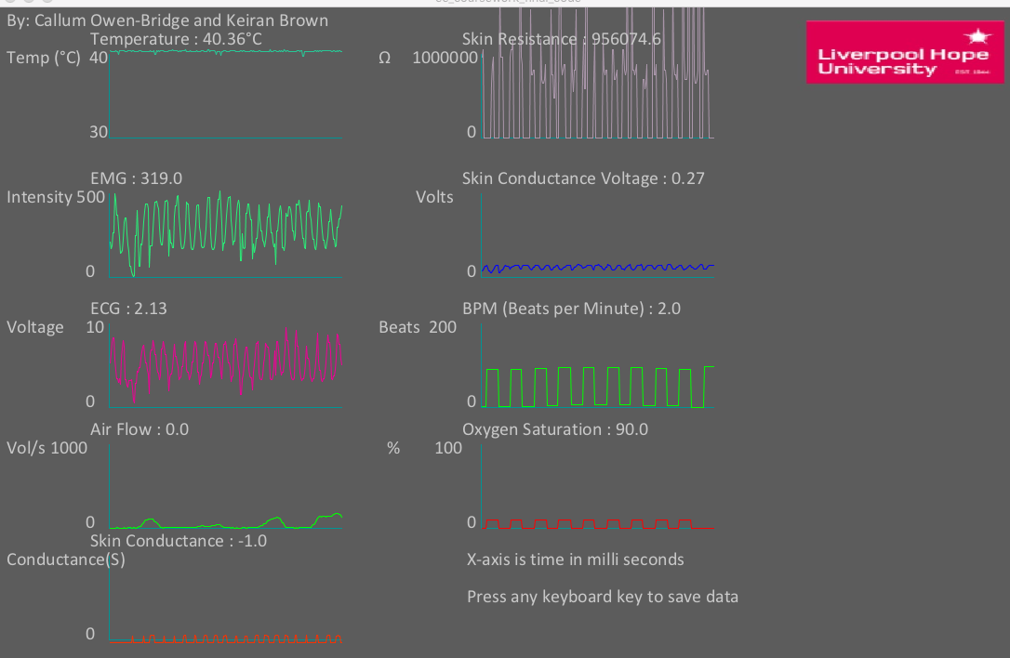
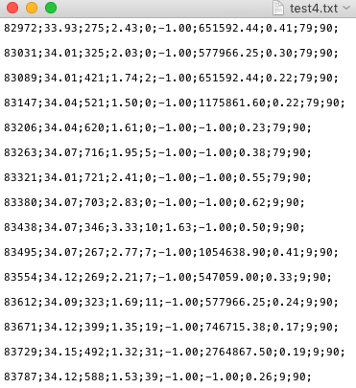
Solution - application

Slide 7
Benefits
Faster consultation results
Health monitoring independence
Can monitor health condition when in working environment
Could save lives
Future ability to warn people if user is at risk
Could help prevent health conditions from degrading
Very portable
More cost and time effective for health care professionals
Modular design
Almost anyone can use it

Slide 8
conclusion
To conclude:
Faster consultation results
Health monitoring independence
Ability to monitor health whilst in working environment
Future ability to monitor relatives in care homes
Continuous data provides more accurate results

